Slide 1
Chongqing University of Technology
ATAI
Advanced Technique of Artificial Intelligence
Chongqing University of Technology
User Behavior Enriched Temporal Knowledge Graphs for Sequential Recommendation
Code：None
—— WSDM 2024
2024.6.13 • ChongQing
Reported by Peng Shan

Slide 2
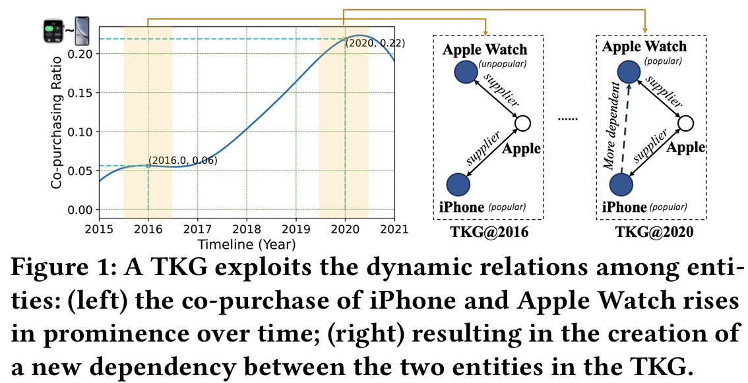
Motivation
（1）The item-centric approach considers only those KG entities statically linked to an item as relevant ones, overlooking entities derived from sequential user behaviors. However, sequential relevance is a strong signal in SR tasks.
（2）Existing user-centric methods rely on static user preferences for identifying relevant entities . However, This approach falls short in SR contexts where user preferences evolve over time.

Slide 3
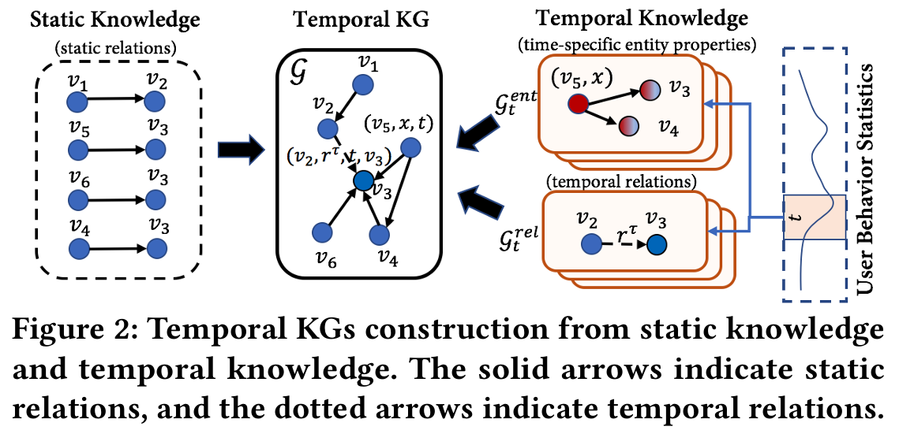
Method

Slide 4
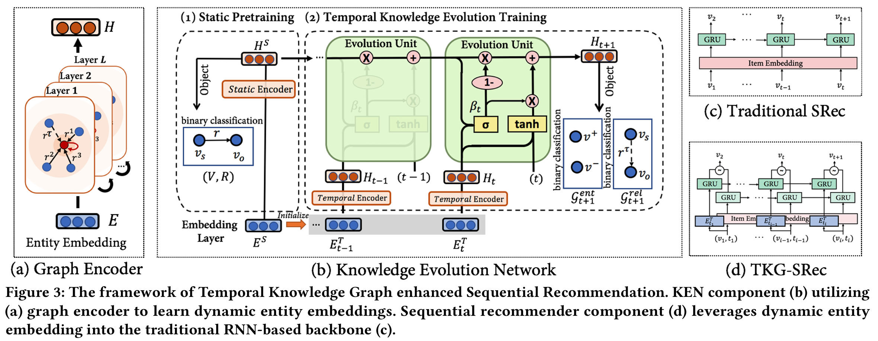
Method

Slide 5
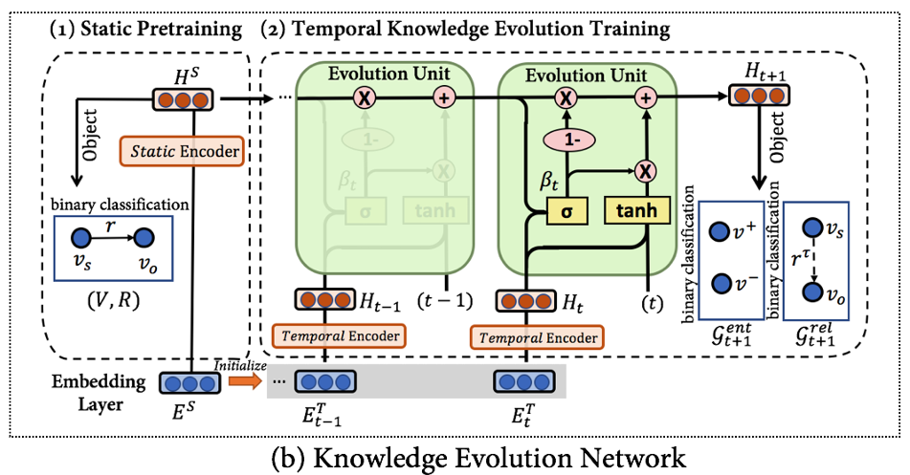
Method

Slide 6
Method

Slide 7
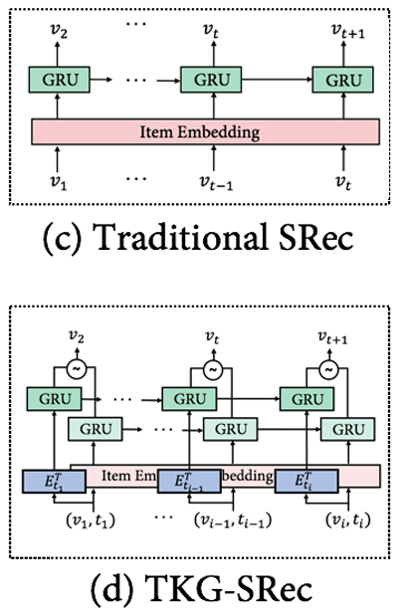
Method

Slide 8
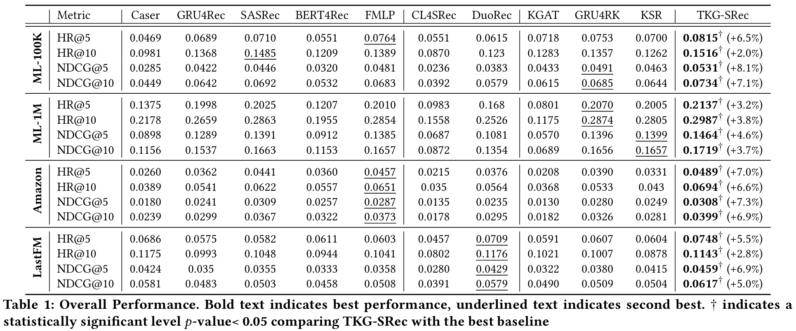
Experiments

Slide 9
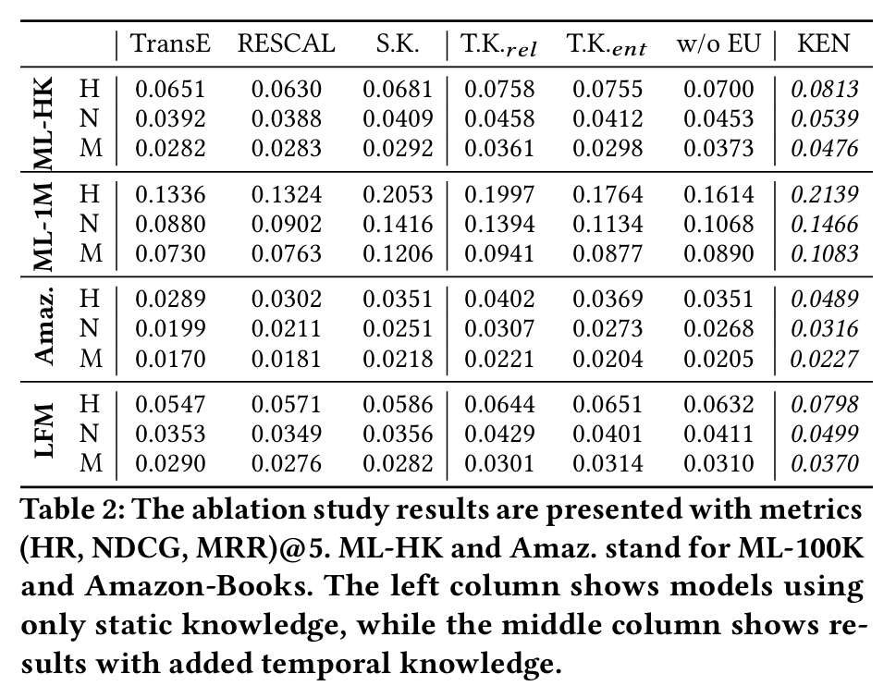
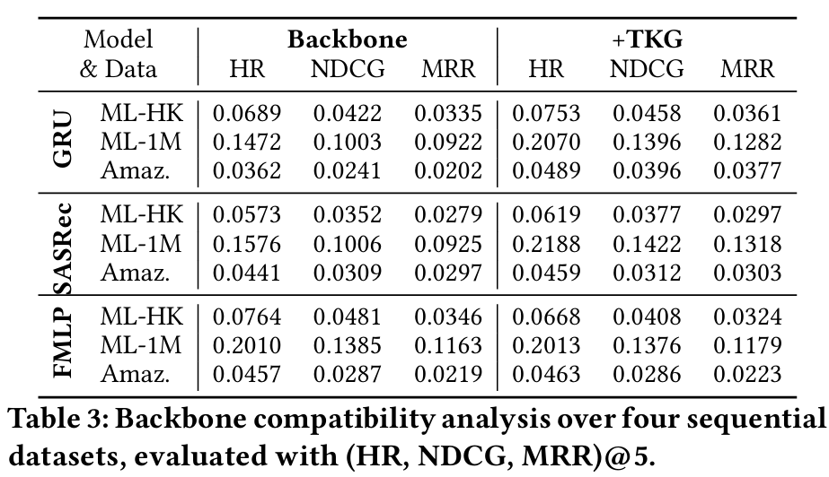
Experiments

Slide 10
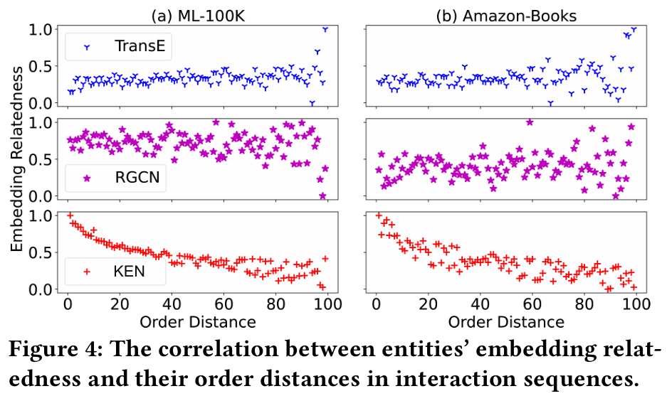
Experiments

Slide 11
Experiments

Slide 12
Thanks!

